Slide 1

Global Food Price Crisis
Which countries suffered most during recent crisis?

Slide 2
DATASETS
World Food Programme Global Food Prices:
Sourced from https://data.humdata.org/dataset/wfp-food-prices; ~250 MB compressed with 1.96 million records across 94 countries, 831 commodities, and 1,500+ markets; monthly data from 2019-2025 including date, country, market, commodity, price, and currency.
World Bank Development Indicators:
From https://data.worldbank.org/; ~10 MB in 2 CSV files covering inflation (FP.CPI.TOTL.ZG) and GDP per capita (NY.GDP.PCAP.CD); annual data for 266 countries from 2019-2024 to correlate food inflation with economic context.
IMF Currency Exchange Rates:
Sourced from https://data.imf.org/ (COFER); ~200 MB file used for normalizing prices during cleaning, though final focus was on percentage inflation to minimize exchange rate dependency.

Slide 3
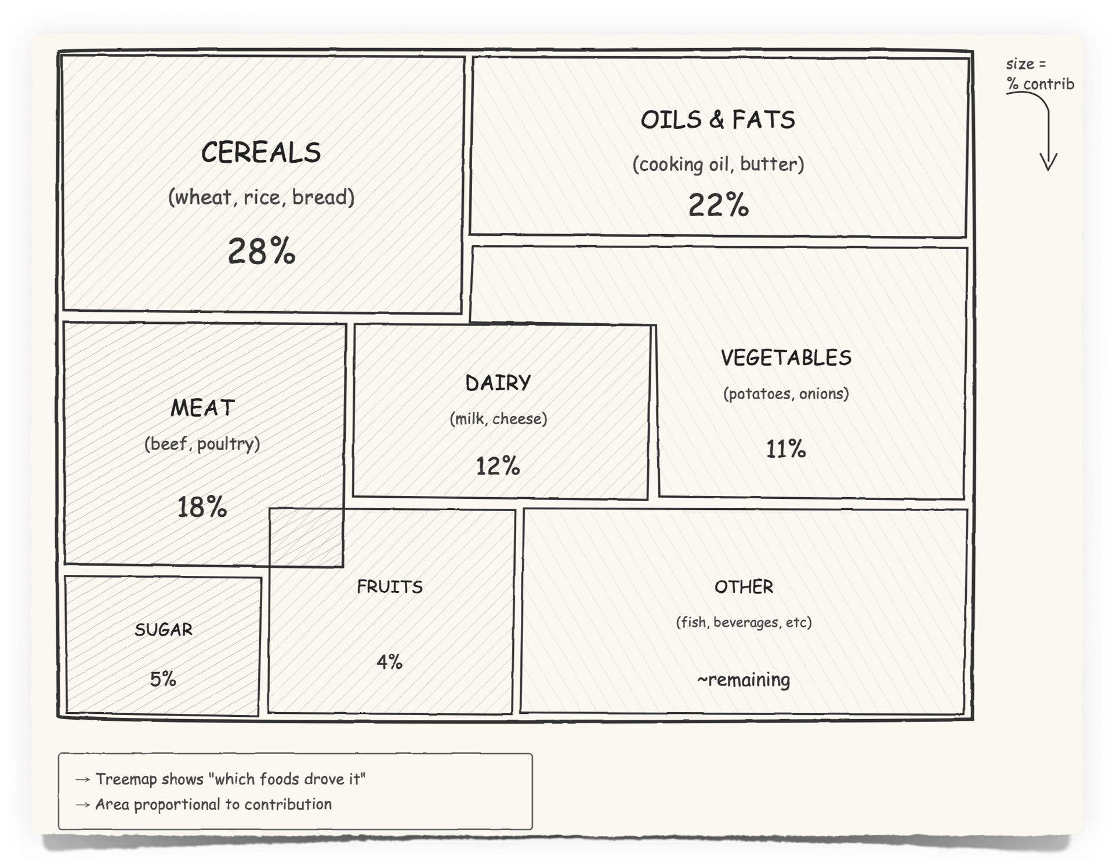
Food Category Contribution to Inflation
The tree map sketch illustrates the contribution of various food categories to inflation, with the area size representing the percentage contribution (e.g., Cereals at 28%, Oils & Fats at 22%, and Meat at 18%).
This map emphasizes the primary drivers, such as staples, providing a comprehensive understanding of the impact of each category on inflation. It serves as a step-by-step guide to comprehending the influence of each category before integrating them into the final visualization.

Slide 4
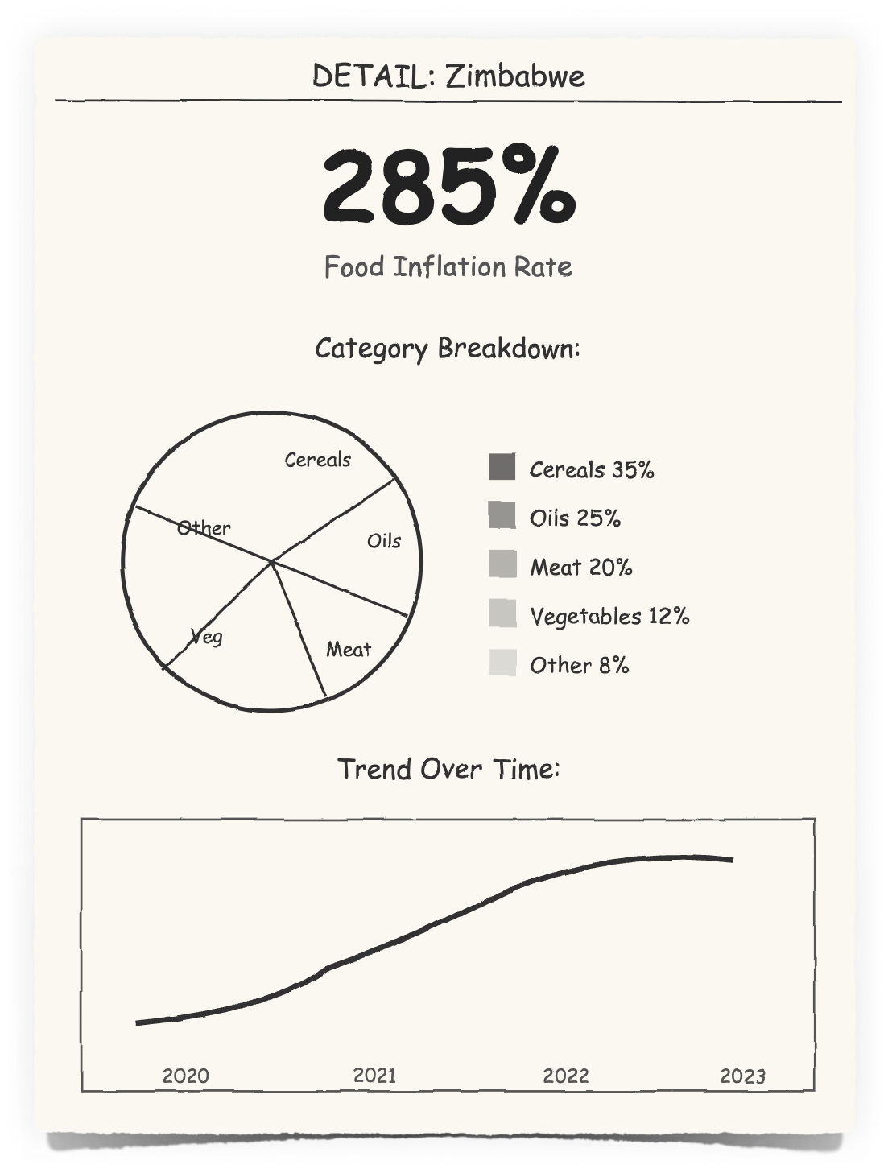
Detailed overview of a country…
Zimbabwe has been analyzed as a comparative case study.
Zimbabwe's cumulative food price inflation rate from the 2019 baseline is 285 %.
From our observations, Cereals, Oils, and Meat constitute the primary contributors to inflation, accounting for over 80% of the total. This substantial impact is evident, as the other categories collectively do not exceed 20%, exacerbating the inflationary situation in Zimbabwe.

